Slide 1
Comparison of SpaCy and BERT Models for Named Entity Recognition (NER)
A Detailed Analysis of Model Performance and System Architecture
By Saurabha Wankhede

Slide 2
Overview
Objectives of the study:
To compare the performance of SpaCy and BERT models on the NER task.
To evaluate the models based on precision, recall, and F1-score.
To understand the system architecture required to deploy these models in a production environment.
Approach and methodology:
Data preprocessing: Cleaning and preparing the dataset for training.
Model training: Training the SpaCy and BERT models on the NER dataset.
Model evaluation: Comparing the models' performance using standard evaluation metrics.
System design: Designing a scalable architecture for deploying the models in production.

Slide 3
Overview
Introduction to NER and its importance:
Named Entity Recognition (NER) is a critical task in natural language processing that involves identifying and classifying named entities in text into predefined categories such as names of persons, organizations, locations, expressions of times, quantities, monetary values, percentages, etc.
NER is crucial for information retrieval, question answering, and summarization tasks as it helps in extracting structured information from unstructured text.
Models used: SpaCy and BERT:
SpaCy: SpaCy is a popular NLP library known for its efficiency and ease of use. In this case study, SpaCy serves as the baseline model for NER, leveraging its pre-trained pipelines to recognize entities in the text.
BERT: BERT (Bidirectional Encoder Representations from Transformers) is a state-of-the-art language model developed by Google. It provides enhanced contextual understanding and is fine-tuned for the NER task, offering improved accuracy over baseline models like SpaCy.

Slide 4
Motivation behind using Spacy
SpaCy's pre-trained models offer good baseline performance for NER tasks.
The en_core_web_sm model can be fine-tuned on custom datasets to improve its accuracy.
SpaCy is effective for smaller datasets and quick prototyping.
Low latency and high speed make it suitable for real-time applications.
Easy integration with other NLP pipelines provided by SpaCy.
Lower computational requirements compared to deep learning models.
Alternative Options:
Flair: A framework for state-of-the-art NLP that offers contextual string embeddings and easy model training.
Polyglot: A natural language pipeline that supports various languages and provides pre-trained NER models.

Slide 5
Motivation behind using BERT
BERT Model:
Motivation:
BERT (Bidirectional Encoder Representations from Transformers) provides state-of-the-art performance on various NLP tasks, including NER.
Provides higher precision, recall, and F1-scores, making it suitable for applications where accuracy is paramount.
Ability to generalize better to unseen data due to its deep learning architecture
Alternative Options:
RoBERTa: A robustly optimized BERT pre-training approach that often outperforms BERT.
XLNet: A generalized autoregressive pre-training method that leverages the best of both BERT and Transformer-XL.
GPT-3: While primarily a generative model, GPT-3 can be fine-tuned for NER and other specific NLP tasks.

Slide 6
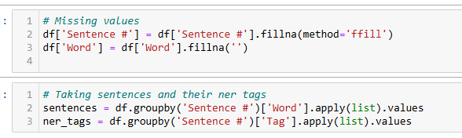
Dataset and Preprocessing
- Dataset:
- Source: ner_dataset.csv
- Preprocessing steps:
- Fill NaN values
- Group words by sentence
- Convert words and tags to lists

Slide 7
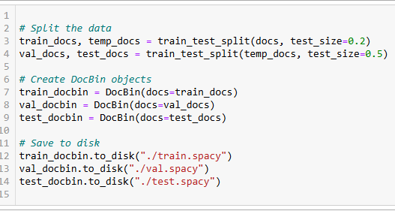
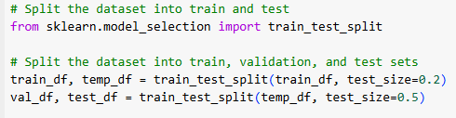


Dataset Splitting
- Split into train, validation, and test sets for both models
# Split the data for spacy
Spacy’s : en_core_web_sm –Small English model
# Split the dataset into train, validation, and test sets for BERT

Slide 8
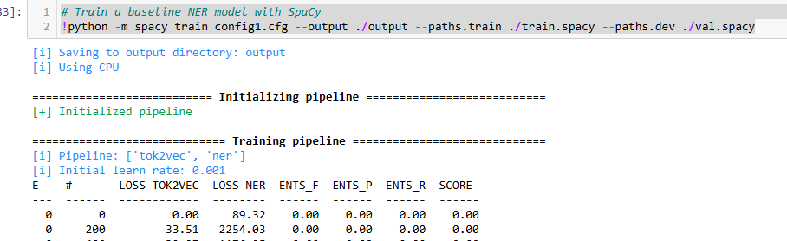
Model Training with SpaCy
# Train a baseline NER model with SpaCy
[i] Pipeline: ['tok2vec', 'ner']
[i] Initial learn rate: 0.001
E # LOSS TOK2VEC LOSS NER ENTS_F ENTS_P ENTS_R SCORE
--- ------ ------------ -------- ------ ------ ------ ------
0 0 0.00 89.32 0.00 0.00 0.00 0.00
[+] Saved pipeline to output directory
output\model-last

Slide 9
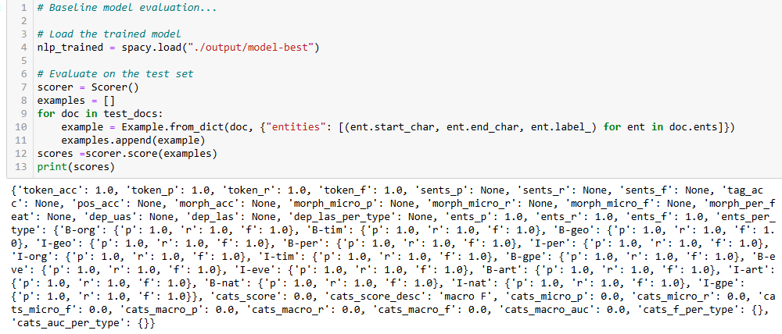
Model Evaluation with SpaCy
# Evaluate on the test set

Slide 10
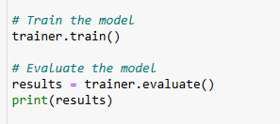
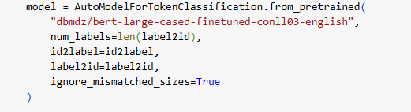
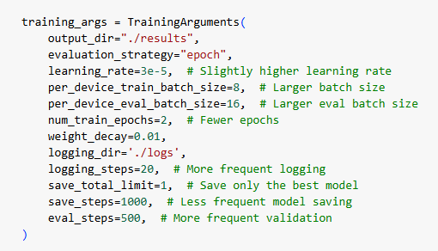
Model Training with BERT Pretrained Bert model fine tuned on CoNLL-03 English dataset

Slide 11
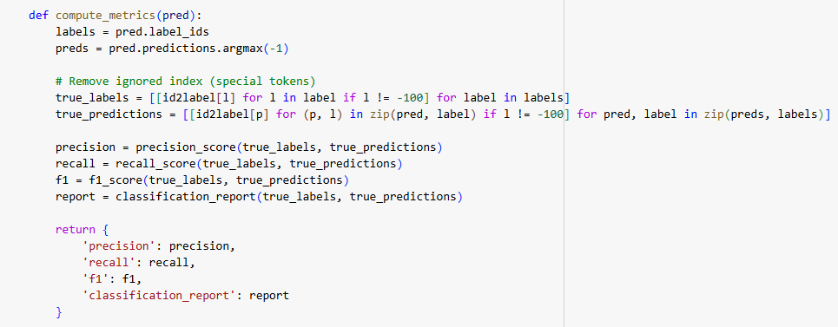
Model Evaluation with BERT

Slide 12
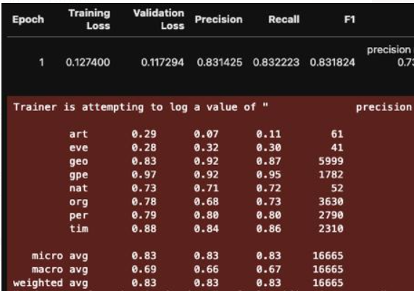
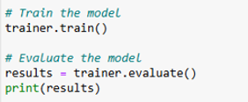
Intermediate result

Slide 13
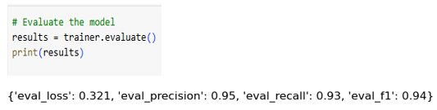
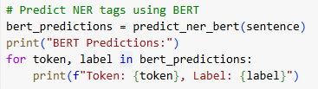
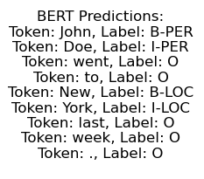
Model Evaluation with BERT

Slide 14
Comparison of SpaCy and BERT
Evaluation Metrics:Precision, Recall, F1-score
Key Differences: SpaCy achieved perfect scores on the test set, which indicate overfitting.
BERT shows robust performance with high precision and recall, suggesting better generalization.
Metric | SpaCy | BERT
Precision | 1.0 | 0.95
Recall | 1.0 | 0.93
F1-score | 1.0 | 0.94

Slide 15
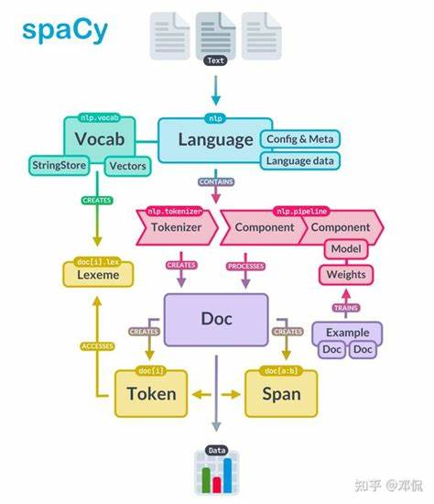
System Architecture for Deployment (SpaCy)
SpaCy Deployment:
Key Components:
Data Preprocessing: Clean and preprocess
data.
Model Training: Train the SpaCy
NER model
Model Deployment: Deploy using Docker
and Kubernetes.
API Creation: Expose model via Flask API.
Monitoring: Use Prometheus and Grafana.

Slide 16
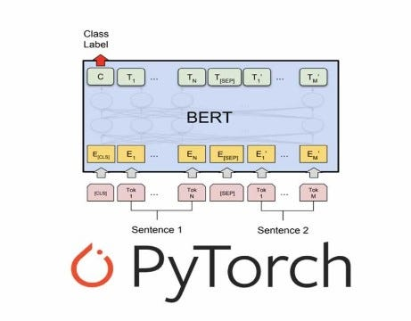
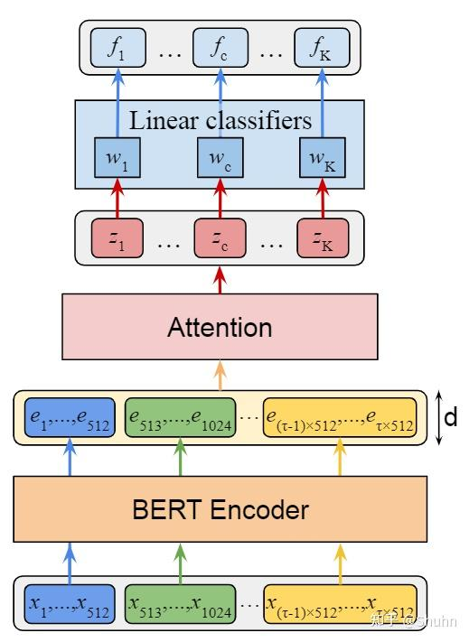
System Architecture for (BERT)

Slide 17
System Architecture for Deployment (BERT)
System Architecture for BERT Deployment:
Key Components:
Data Preprocessing: Clean and preprocess data.
Model Training: Train the BERT NER model.
Model Deployment: Deploy using TensorFlow Serving or TorchServe.
API Creation: Expose model via Flask or FastAPI.
Monitoring: Use Prometheus and Grafana.

Slide 18
Future Work and Optimization
SpaCy:
Fine-tune hyperparameters to avoid overfitting.
Explore advanced techniques for better generalization
BERT:
Perform hyperparameter tuning for better performance.
Implement continuous monitoring for model drift.
Explore distributed training for scalability.

